Slide 1
Statistical Language Processing
In the solution of some problems in the natural language processing, statistical techniques can be also used.
  optical character recognition
  spelling correction
  speech recognition
  machine translation
  part of speech tagging
  parsing
Statistical techniques can be used to disambiguate the input.
They can be used to select the most probable solution.
Statistical techniques depend on the probability theory.
To able to use statistical techniques, we will need corpora to collect statistics. Corpora should be big enough to capture the required knowledge.
BİL711 Natural Language Processing

Slide 2
Basic Probability
Probability Theory: predicting how likely it is that something will happen.
Probabilities: numbers between 0 and 1.
Probability Function:
  P(A) means that how likely the event A happens.
  P(A) is a number between 0 and 1
  P(A)=1 => a certain event
  P(A)=0 => an impossible event
Example: a coin is tossed three times. What is the probability of 3 heads?
  1/8
  uniform distribution
BİL711 Natural Language Processing

Slide 3
Probability Spaces
There is a sample space and the subsets of this sample space describe the events.
Ω is a sample space.
  Ω is the certain event
  the empty set is the impossible event.
Ω
P(A) is between 0 and 1
P(Ω) => 1
A
BİL711 Natural Language Processing

Slide 4
Unconditional and Conditional Probability
Unconditional Probability or Prior Probability
  P(A)
  the probability of the event A does not depend on other events.
Conditional Probability -- Posterior Probability -- Likelihood
  P(A|B)
  this is read as the probability of A given that we know B.
Example:
  P(put) is the probability of to see the word put in a text
  P(on|put) is the probability of to see the word on after seeing the word put.
BİL711 Natural Language Processing

Slide 5
Unconditional and Conditional Probability (cont.)
A
B
P(A|B) = P(A∩B) / P(B)
A∩B
P(B|A) = P(B∩A) / P(A)
BİL711 Natural Language Processing

Slide 6
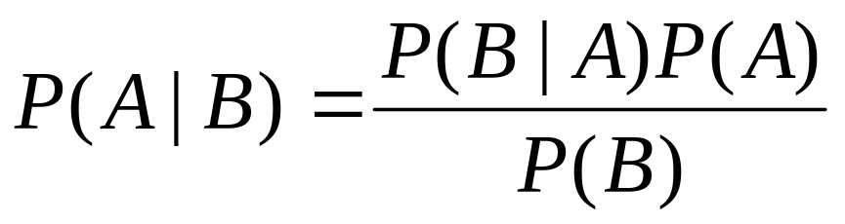
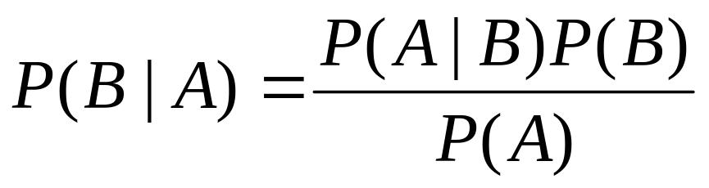
Bayes’ Theorem
Bayes’ theorem is used to calculate P(A|B) from given P(B|A).
We know that:
P(A∩B) = P(A|B) P(B)
P(A∩B) = P(B|A) P(A)
So, we will have:
BİL711 Natural Language Processing

Slide 7
The Noisy Channel Model
Many problems in natural language processing can be viewed as noisy channel model.
  optical character recognition
  spelling correction
  speech recognition
  …..
guess at
original word
word
noisy
DECODER
SOURCE
word
noisy channel
Noisy channel model for pronunciation
BİL711 Natural Language Processing

Slide 8
Applying Bayes to a Noisy Channel
In applying probability theory to a noisy channel, what we are looking for is the most probable source given the observed signal. We can denote this:
mostprobable-source = argmax_{Source} P(Source|Signal)
Unfortunately, we don’t usually know how to compute this.
  We cannot directly know : what is the probability of a source given an observed signal?
  We will apply Bayes’ rule
BİL711 Natural Language Processing

Slide 9
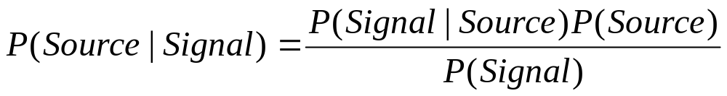
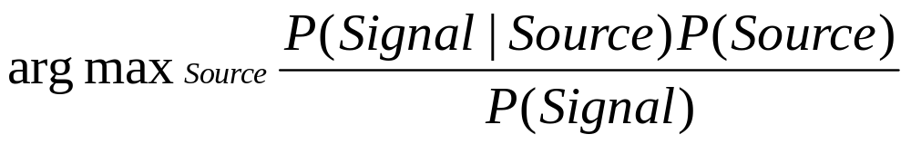
Applying Bayes to a Noisy Channel (cont.)
From Bayes rule, we know that:
So, we will have:
For each Source, P(Signal) will be same. So we will have:
argmax_{Source} P(Signal|Source) P(Source)
BİL711 Natural Language Processing

Slide 10
Applying Bayes to a Noisy Channel (cont.)
In the following formula
argmax_{Source} P(Signal|Source) P(Source)
Can we find the value of P(Signal|Source) and P(Source)?
Yes, we may evaluate those values from corpora.
  We may need a huge corpus.
  Although we may have a huge corpus, it can be still difficult to compute those values.
  For example, when Signal is a speech representing a sentence, and we are trying to estimate Source representing that sentence.
  In those cases, we will use approximate values. For example, we may use N-grams to compute those values.
So, we will know the probability spaces of possible sources.
  We can plug each of them into the equation one by one and compute their probabilities using this equation.
  The source hypothesis with the highest probability wins.
BİL711 Natural Language Processing

Slide 11
Applying Bayes to a Noisy Channel to Spelling
We have some word that has been misspelled and we want to know the real word.
In this problem, the real word is the source and the misspelled word is the signal.
We are trying to estimate the real word.
Assume that
V is the space of all the words we know
s denotes the misspelling (signal)
ϖ denotes the correct word (estimate)
So, we will have the following equation:
ϖ = argmax_{w∈V} P(s|w) P(w)
BİL711 Natural Language Processing

Slide 12
Getting Numbers
We need a corpus to compute: P(w) and P(s|w)
Computing P(w)
  We will count how often the word w occurs in the corpus.
  So, P(w) = C(w)/N where C(w) is the number of w occurs in the corpus,
  and N is the total number of words in the corpus.
  What happens if P(w) is zero.
    We need a smoothing technique (getting rid of zeroes).
    A smoothing technique: P(w) = (C(w)+0.5) / (N+0.5*VN)
    where VN is the number of words in V (our dictionary).
Computing P(s|w)
  It is fruitless to collect statistics about the misspellings of individual words
  for a given dictionary. We will likely never get enough data.
  We need a way to compute P(s|w) without using direct information.
  We can use spelling error pattern statistics to compute P(s|w).
BİL711 Natural Language Processing

Slide 13
Spelling Error Patterns
There are four patterns:
Insertion -- ther for the
Deletion -- ther for there
Substitution -- noq for now
Transposition -- hte for the
For each pattern we need a confusion matrix.
  del[x,y] contains the number of times in the training set that characters xy
  in the correct word were typed as x.
  ins[x,y] contains the number of times in the training set that character x
  in the correct word were typed as xy.
  sub[x,y] contains the number of times that x was typed as y.
  trans[x,y] contains the number of times that xy was typed as yx.
BİL711 Natural Language Processing

Slide 14
Estimating p(s|w)
Assuming a single spelling error, p(s|w) will be computed as follows.
p(s|w) = del[w_{i-1},w_{i}] / count[w_{i-1}w_{i}] if deletion
p(s|w) = ins[w_{i-1},s_{i}] / count[w_{i-1}] if insertion
p(s|w) = sub[s_{i},w_{i}] / count[w_{i}] if substitution
p(s|w) = trans[w_{i},w_{i+1}] / count[w_{i}w_{i+1}] if transposition
BİL711 Natural Language Processing

Slide 15
Kernighan Method for Spelling
Apply all possible single spelling changes to the misspelled word.
Collect all the resulting strings that are actually words (V)
Compute the probability of each candidate words.
Display them ranked to the user
BİL711 Natural Language Processing

Slide 16
Problems with This Method
Does not incorporate contextual information (only local information)
Needs hand-coded training data
How to handle zero counts (Smoothing)
BİL711 Natural Language Processing

Slide 17
Weighted Automata/Transducer
Simply converting simple probabilities into a machine representation.
  A sequence of states representing inputs (phones, letters, …)
  Transition probabilities representing the probability of one state following another.
Weighted Automaton/Transducer is also known as Probabilistic FSA/FST.
A Weighted Automaton can be shown that it is equivalent to Hidden Markov Model (HMM) used in speech processing.
BİL711 Natural Language Processing

Slide 18
Weighted Automaton Example
0.52
n
iy
end
0.48
t
possible phonemes for the word neat
BİL711 Natural Language Processing

Slide 19
Tasks
Given probabilistic models, we can want to be able to answer the following questions.
  What is the probability of a string generated by a machine?
  What is the most likely path through a machine for a given string?
  What is the most likely output for a given input?
  How can we get the best right numbers onto the arcs?
Given a observation sequence and a set of machines:
  Can we determine the probability of each machine having produced that string.
  Can we find the most likely machine for given string.
BİL711 Natural Language Processing

Slide 20
Dynamic Programming
Dynamic programming approaches operate by solving small problems once, and remembering the answer in a table of some kind.
Not all solved sub-problems will play a role in the final problem solution.
When a solved sub-problem plays a role in the solution to the overall problem, we want to make sure that we use the best solution to that sub-problem.
Therefore we also need some kind of optimization criteria that indicates that a given solution to a sub-problem is the best solution.
So, when we are storing solutions to sub-problems we only need to remember the best solution to that problem (not all the solutions).
BİL711 Natural Language Processing

Slide 21
Viterbi Algorithm
Viterbi algorithm uses dynamic programming technique.
Viterbi algorithm tries the best path in a weighted automaton
for a given observation.
We need the following information in the Viterbi algorithm:
  previous path probability -- viterbi[i,t] the best path for the first t-1 steps for state i.
  transition probability -- a[i,j] from previous state i to current state j.
  observation likelihood -- b[j,t] the current state j matches the observation symbol t.
    For the weighted automata that we consider b[j,t] is 1 if the observation symbol matches the state, and 0 otherwise.
BİL711 Natural Language Processing

Slide 22
Viterbi Algorithm (cont.)
function VITERBI(observations of len T, state-graph) returns best-path
num-states ← NUM-OF-STATES(state-graph);
Create a path probability matrix viterbi[num-states+2,T+2];
viterbi[0,0] ← 1.0;
for each time step t from 0 to T do
for each state s from 0 to num-states do
for each transtion sp from s specified by state-graph
new-score ← viterbi[s,t] * a[s,sp] * b[sp,o_{t}];
if ((viterbi[sp,t+1]=0) || (new-score > viterbi[sp,t+1])) then {
viterbi[sp,t+1] ← new-score;
back-pointer[sp,t+1] ← s;
}
Backtrace from the highest probability state in the final column of viterbi, and return the path.
BİL711 Natural Language Processing

Slide 23
A Pronunciation Weighted Automata
n
iy
.00024
knee
.11
n
iy
.89
d
end
.00056
need
start
.001
new
.64
uw
n
.36
.00013
neat
iy
.48
n
iy
.52
t
BİL711 Natural Language Processing

Slide 24
Viterbi Example
end .00036*1.0=.00036
t
neat iy .00013*1.0=.00013
n 1.0*.00013=.00013
d
need iy .00056*1.0=.00056
n 1.0*.00056=.00056
uw
new iy .001*.36=.00036
n 1.0*.001=.001
knee iy .000024*1.0=.000024
n 1.0*.000024=.000024
start 1.0
# n iy #
BİL711 Natural Language Processing

Slide 25
Language Model
In statistical language applications, the knowledge of the source
is referred as Language Model.
We use language models in the various NLP applications:
  speech recognation
  spelling correction
  machine translation
  …..
N-GRAM models are the language models which are widely
used in NLP domain.
BİL711 Natural Language Processing

Slide 26
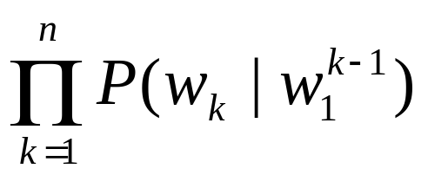
Chain Rule
The probability of a word sequence w₁w₂…w_{n} is:
P(w₁w₂…w_{n} )
We can use the chain rule of the probability to decompose this probability:
P(w₁^{n}) = P(w₁)P(w₂|w₁) P(w₃|w₁²) … P(w_{n}|w₁^{n-1})
=
Example
P(the man from jupiter) =
P(the)P(man|the)P(from|the man)P(jupiter|the man from)
BİL711 Natural Language Processing

Slide 27
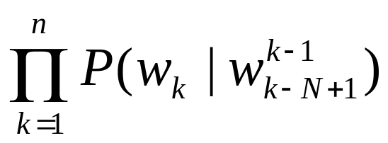
N-GRAMS
To collect statistics to compute the functions in the following forms is difficult (sometimes impossible):
P(w_{n}|w₁^{n-1})
Here we are trying to compute the probability of seeing w_{n} after seeing w₁^{n-1}.
We may approximate this computation just looking
N previous words:
P(w_{n}|w₁^{n-1}) ≈ P(w_{n}|w_{n-N+1}^{n-1})
So, a N-GRAM model
P(w₁^{n}) ≈
BİL711 Natural Language Processing

Slide 28
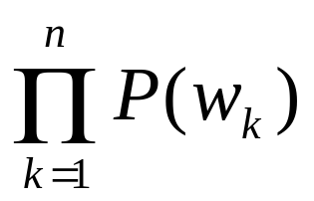
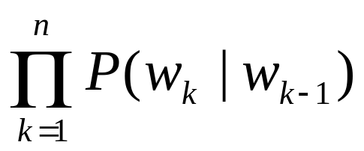
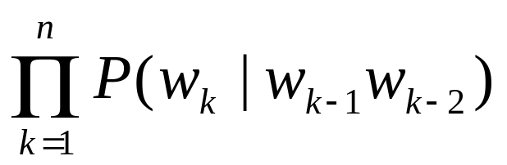
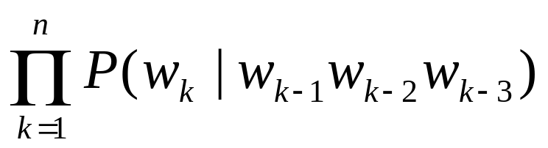
N-GRAMS (cont.)
Unigrams -- P(w₁^{n}) ≈
Bigrams -- P(w₁^{n}) ≈
Trigrams -- P(w₁^{n}) ≈
Quadrigrams -- P(w₁^{n}) ≈
BİL711 Natural Language Processing

Slide 29
N-Grams Examples
Unigram
P(the man from jupiter) ≈ P(the)P(man)P(from)P(jupiter)
Bigram
P(the man from jupiter) ≈ P(the|s)P(man|the)P(from|man)P(jupiter|from)
Trigram
P(the man from jupiter) ≈
P(the|s s)P(man|s the)P(from|the man)P(jupiter|man from)
BİL711 Natural Language Processing

Slide 30
Markov Model
The assumption that the probability of a word depends only
on the previous word is called Markov assumption.
Markov models are the class of probabilistic models that
assume that we can predict the probability of some future
unit without looking too far into the past.
A bigram is called a first-order Markov model (because it
looks one token into the past);
A trigram is called a second-order Markov model;
In general a N-Gram is called a N-1 order Markov model.
BİL711 Natural Language Processing

Slide 31
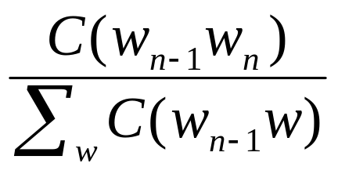
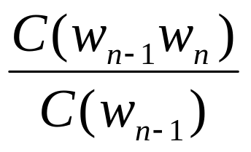
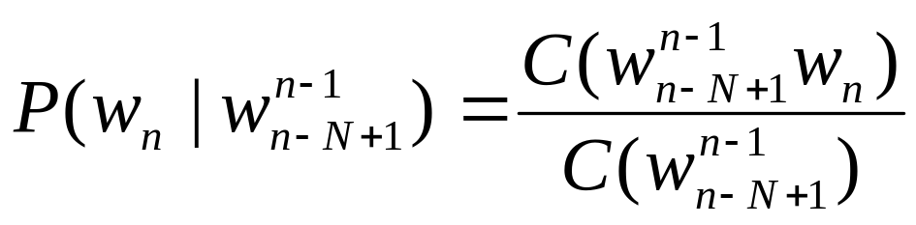
Estimating N-Gram Probabilities
Estimating bigram probabilities:
P(w_{n}|w_{n-1}) =
=
Where C is the count of
that pattern in the corpus
Estimating N-Gram probabilities
BİL711 Natural Language Processing

Slide 32
Which N-Gram?
Which N-Gram should be used a language model?
  Unigram,Bigram,Trigram,…
Bigger N, the model will be more accurate.
  But we may not get good estimates for N-Gram probabilities.
  The N-Gram tables will be more sparse.
Smaller N, the model will be less accurate.
  But we may get better estimates for N-Gram probabilities.
  The N-Gram table will be less sparse.
In reality, we do not use higher than Trigram (not more than Bigram).
How big are N-Gram tables with 10,000 words?
  Unigram -- 10,000
  Bigram -- 10000*10000 = 100,000,000
  Trigram -- 10000*10000*10000 = 1,000,000,000,000
BİL711 Natural Language Processing

Slide 33
Smoothing
Since N-gram tables are too sparse, there will be a lot of entries with zero probability (or with very low probability).
The reason for this, our corpus is finite and it is not big enough
to get that much information.
The task of re-evaluating some of zero-probability and
low-probability N-Grams is called Smoothing.
Smoothing Techniques:
  add-one smoothing -- add one to all counts.
  Witten-Bell Discounting -- use the count of things you have seen once to help estimate the count of things you have never seen.
  Good-Turing Discounting -- a slightly more complex form of Witten-Bell Discounting
  Backoff -- using lower level N-Gram probabilities when N-gram probability is zero.
BİL711 Natural Language Processing

